Slide 1
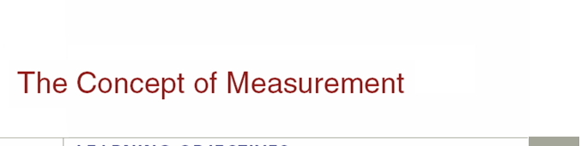

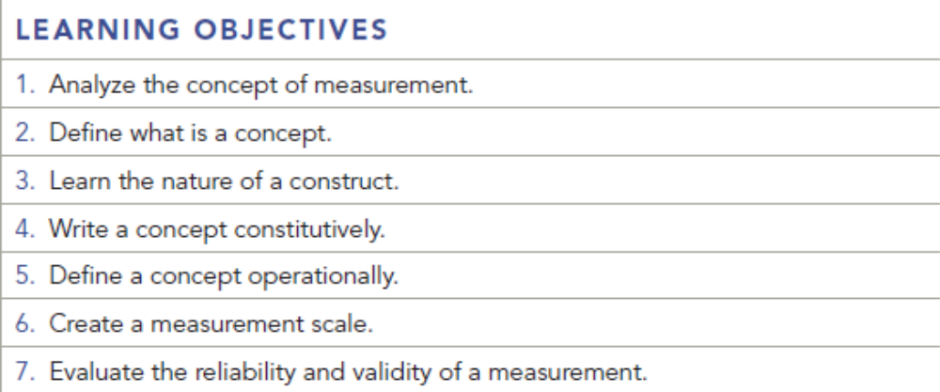
Chapter Ten
10-1

Slide 2
Question
Give an example of a scale that would be reliable but not valid. Also give an example of a scale that would be reliable but not valid. Also give an example of a scale that would be valid but not reliable.

Slide 3
Answer
If we were trying to measure customer satisfaction, but the questionnaire consistently measured customer loyalty, the scale would be reliable in that it measured the construct consistently.
However, it would not be valid, because it did not measure what was intended. If a questionnaire measures customer service accurately, but the results are significantly different when the survey is repeated a week later, it is not reliable.

Slide 4
Question
What are three methods of assessing reliability?

Slide 5
Answer
Test-retest reliability – Repeat the same survey two weeks later with the same sample of people.
Equivalent form – Use similar questionnaires, and then compare the correlations of similar test items.
Internal consistency – use same instrument with two different samples, or sometimes split the sample into halves.

Slide 6
Question
What are three methods of assessing validity?

Slide 7
Answer
Face validity - The researcher has to make a judgment as to whether the measure “looks like” it measures what it is supposed to.
Content validity - Does the scale provide adequate coverage of the topic under study? For example, research has identified five sexes. (That’s true.) If accurate measurement of the respondents’ sex is important to the research, then only offering two choices, Male and Female, is inadequate to provide content validity.
Criterion-related validity - How well can the measurement instrument predict a variable?

Slide 8
Question
If a restaurant customer satisfaction questionnaire lacked a question concerning the quality of the food being served, we’d say the questionnaire lacked______ validity.
a. content
b. face
c. construct
d. criterion-related
e. none of these

Slide 9
Answer
Ans: A

Slide 10
Question
When a researcher wants to show the differences separating two objects, the ideal type of scale to use is _________________.
a. nominal
b. ordinal
c. interval
d. none of these

Slide 11
Answer
Ans: C

Slide 12
Question
Which of the following is not a way to assess reliability?
test-retest reliability
equivalent form reliability
internal consistency reliability
spilt-half technique
criterion- related reliability

Slide 13
Answer
Ans: E

Slide 14
Question
Revise the following assessment of customer satisfaction for Jim Dandy’s Hamburger Joint so that content validity is achieved.
Please indicate your satisfaction with Jim Dandy’s Hamburger Joint using a scale of 1=very satisfied, 2=somewhat satisfied, and 3=not satisfied.
____a. location of the restaurant
____b. cleanliness of restrooms
____c. friendliness of staff
____d. speed of service
____e. restaurant cleanliness
____f. availability of condiments
____g. efficiency of drive-up window
____h. hours of operation

Slide 15
Answer
Ans: All of the attributes above are important to the assessment of satisfaction at Jim Dandy’s. However, there is one serious violation of content validity: there is no assessment of food quality.

Slide 16
Question
Define Validity. Then provide an example of Face Validity and an example of a question that has a Face Validity problem.

Slide 17
Answer
Validity is the degree to which what the researcher is trying to measure is actually measured, such as the extent to which a question or series of questions in a questionnaire actually measure a concept. Face Validity is the degree to which a measure seems to measure what it is supposed to measure. An example would be as follows:
A question asking college students to respond to an age category question when the target market is defined as traditional college age students.
Question: Please indicate your age by marketing the appropriate blank below:
_____0-18 _____19-34 _____35-54 ____55 and over
The categories above would not be appropriate for traditional college ages students and therefore would not adequately measure a population consisting of college students. A better scale would be as follows:
_____0-18 _____19-21 _____22-25 ____26 and over

Slide 18
Question
  The local Ford dealership is interested in collecting data to answer the following information research question: How likely are young adults to purchase a new automobile within a year after graduating from college? Design a nominal, ordinal, interval, and ratio scale measurement that will enable the dealership to collect the required data. In your opinion, which one of your designs would be most useful to the dealership and why?

Slide 19
Answer
Nominal Scale Design:
How likely are you to purchase a new automobile within one year after graduating from college?
[ ] Do intend to purchase
[ ] Do not intend to purchase

Slide 20
Answer
Ordinal Scale Design:
Please check the one response that best expresses how likely you are to purchase a new automobile within one year after graduating from college?
[ ] Definitely will purchase
[ ] Unlikely will purchase
[ ] Probably will purchase
[ ] Definitely will not purchase

Slide 21
Answer
Interval Scale:
Which one of the following percentages ranges best approximates the likelihood of you purchasing a new automobile within one year after graduating from college?
[ ] less than 10% chance
[ ] 11% - 49% chance
[ ] 50 – 79% chance
[ ] 90 – 100% chance

Slide 22
Answer
Ratio Scale:
In the space provided below, please write the percentage value that best approximates the likelihood [chance] of you purchasing a new automobile within one year after graduating from college.
______

